Slide 1
Compass Digital Labs Sales Forecast
March 2nd, 2017
Werner Chao

Slide 2
Outline
Data Cleaning
Data Exploratory
Statistical Testing
Dickey-Fuller test
ACF/PACF plots
Model Building
Forecasting
Improvements – XGBoost
Feature engineering
Parameters
Forecast

Slide 3
Outline
Data Cleaning
Data Exploratory
Statistical Testing
Dickey-Fuller test
ACF/PACF plots
Model Building
Forecasting
Improvements – XGBoost
Feature engineering
Parameters
Forecast

Slide 4
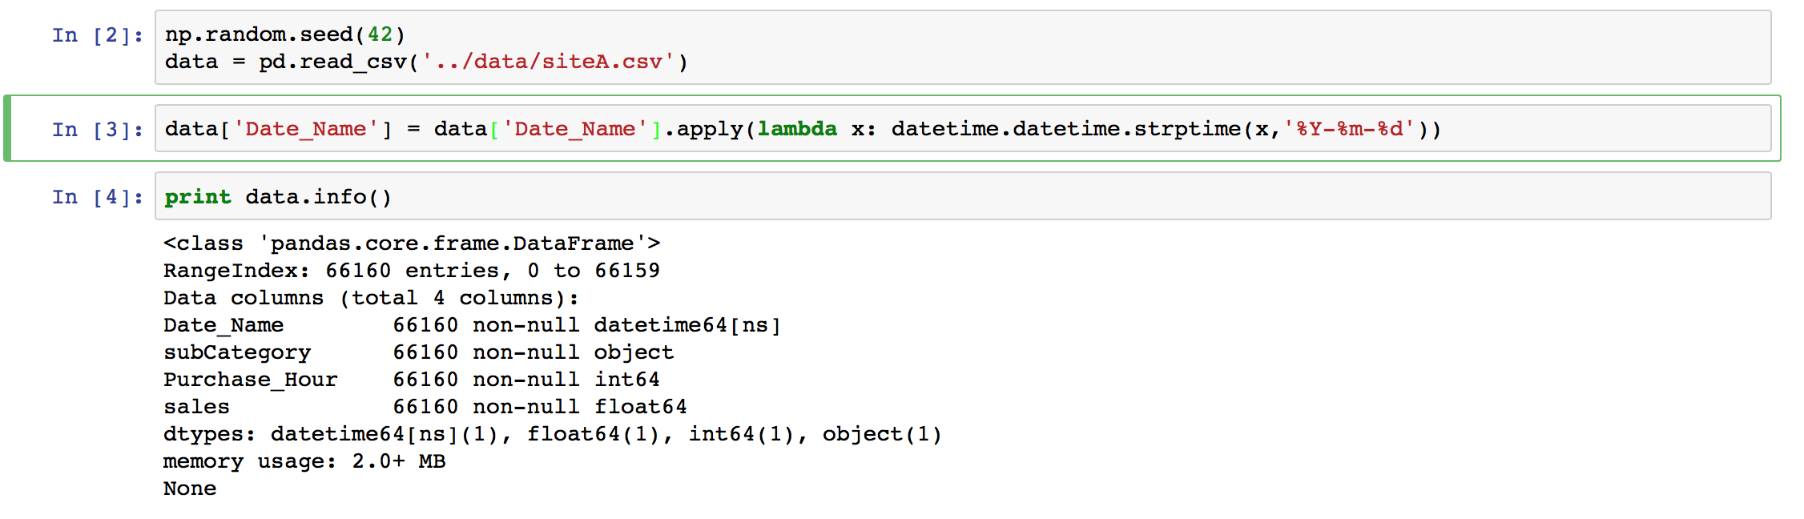
1) Data Cleaning
Format 'date' column to proper format¶

Slide 5
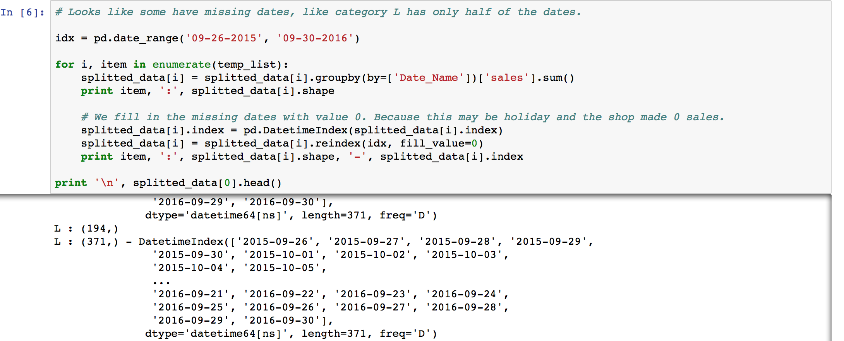
1) Data Cleaning
Fill in missing dates, i.e. category L only has half of the dates¶
Fill the missing sales values with 0 - assume 0 sales for that day due to holiday

Slide 6
Outline
Data Cleaning
Data Exploratory
Statistical Testing
Dickey-Fuller test
ACF/PACF plots
Model Building
Forecasting
Improvements – XGBoost
Feature engineering
Parameters
Forecast

Slide 7
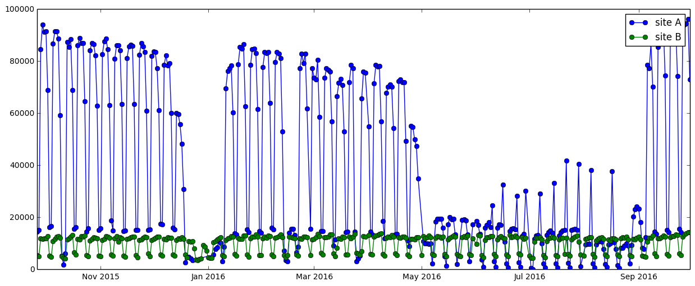
2) Data Exploratory – Both Sites
Site A has a lot of variations; site B is fairly stationary
X’mas no sales
Summer low volume
Some spikes

Slide 8
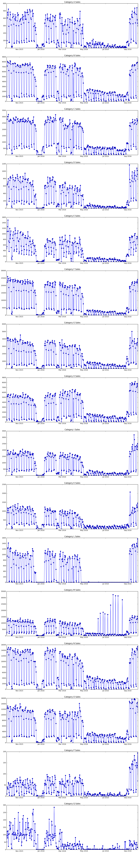
2) Data Exploratory (Site A) – Q
Q: lots of variances, doesn’t follow the overall curve dynamics

Slide 9
2) Data Exploratory (Site A) – L & M
L: zero sales during the summer
M: some spikes, promotional events?

Slide 10
2) Data Exploratory – Both Sites
Focus on Site A. More difficult case.
X’mas no sales
Summer low volume
Some spikes

Slide 11
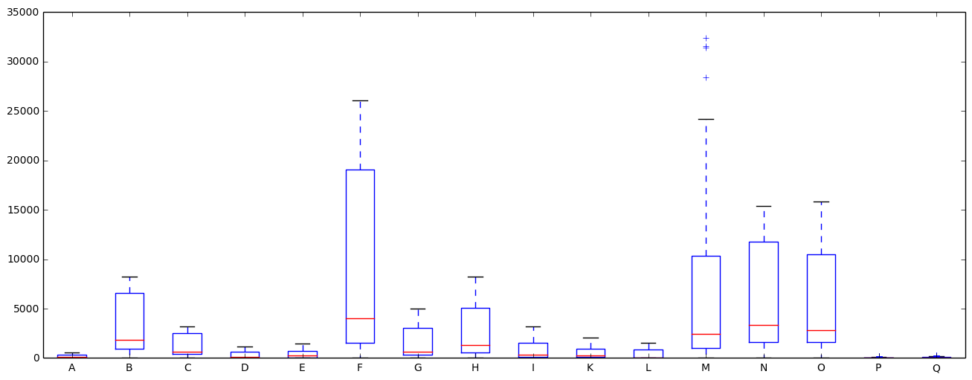
2) Data Exploratory (Site A) – Box Plot
Boxplots tell us:
50% of the observations are below a small dollar value
75% of the observations are below a large dollar value
Large value span from 50%~75% percentile

Slide 12
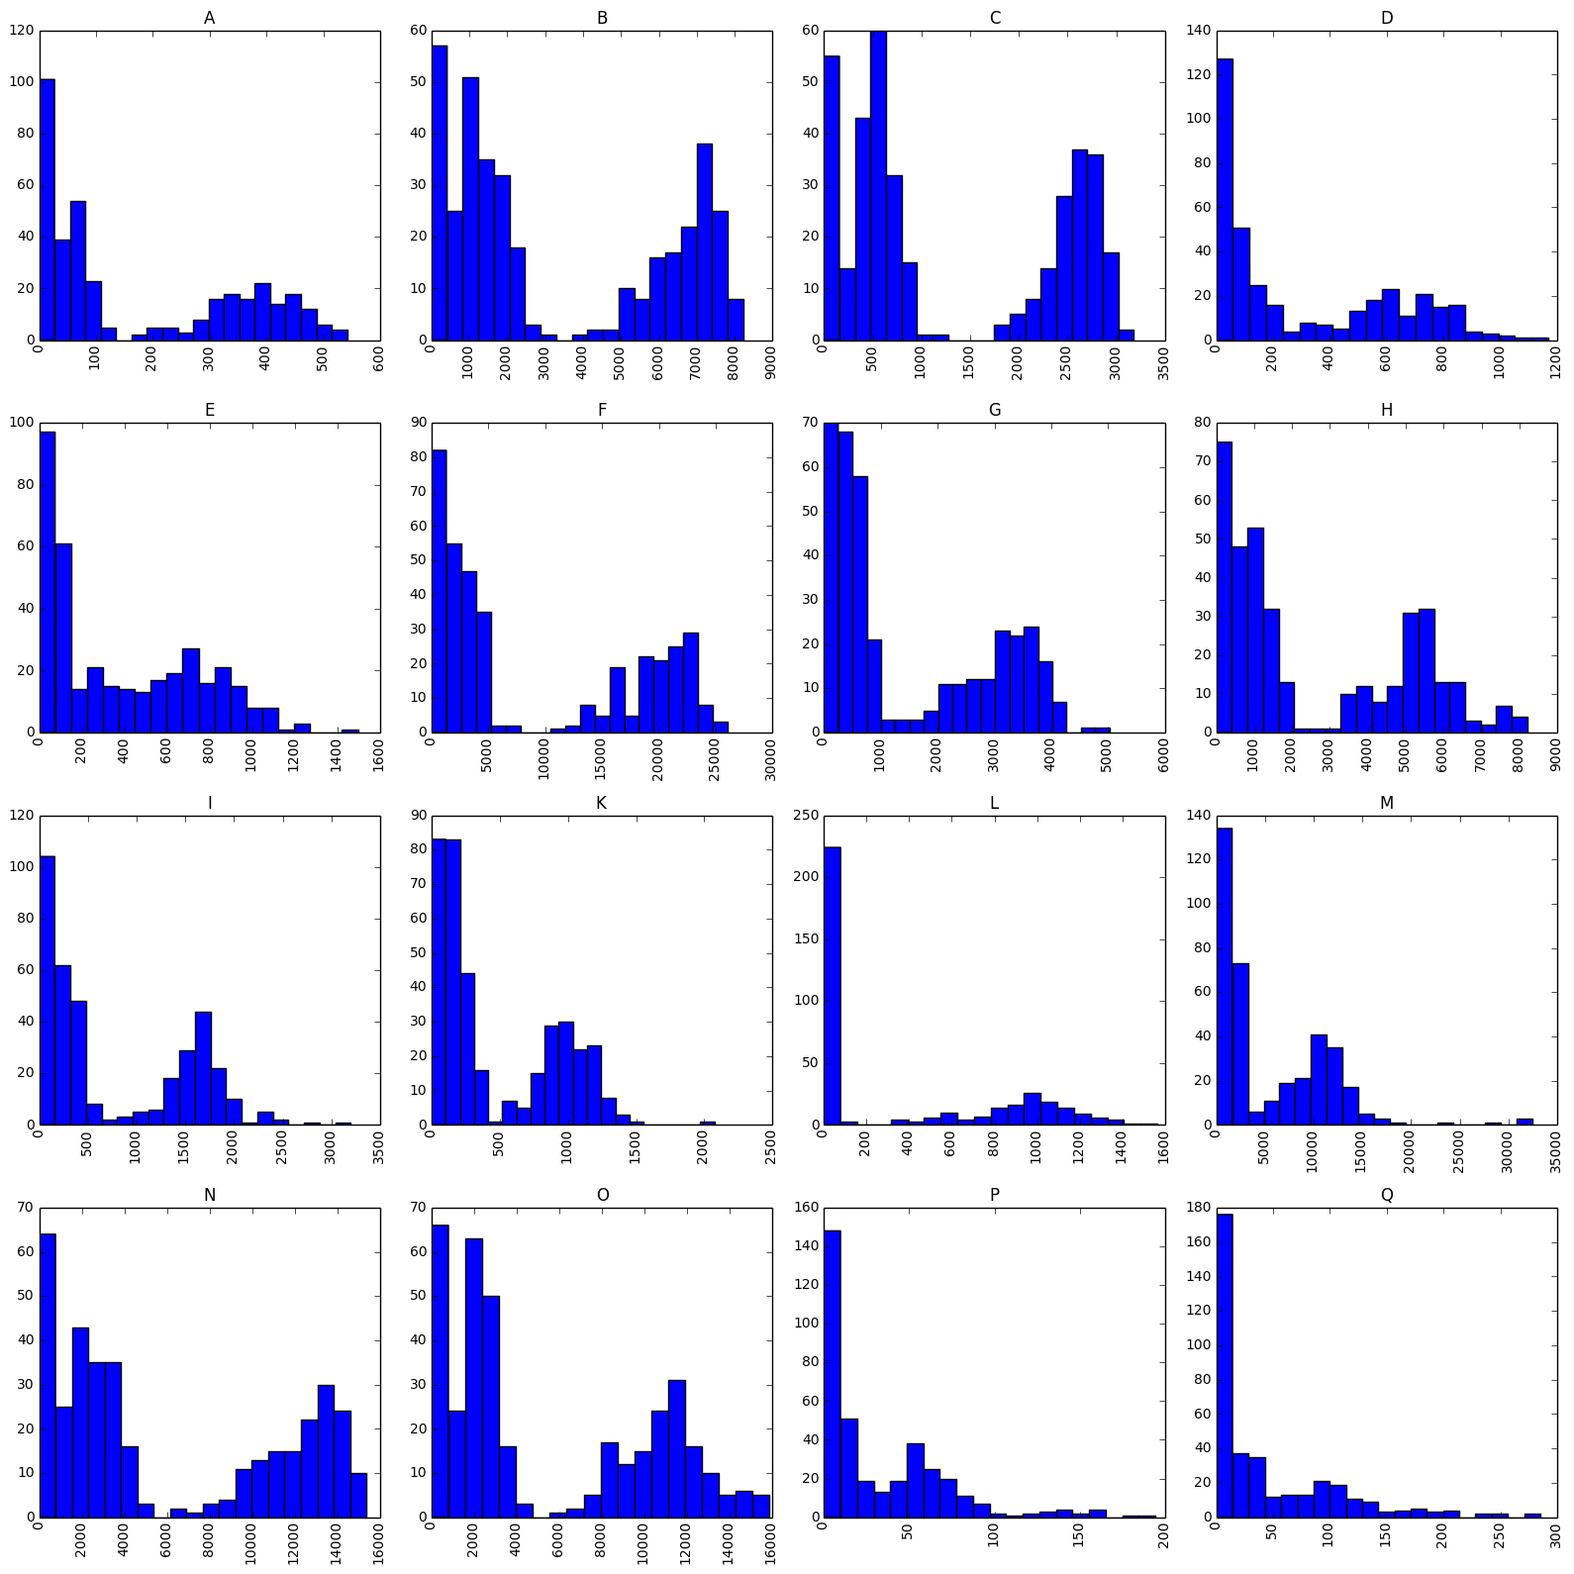
2) Data Exploratory (Site A) - Histograms
2 groups:
Non-summer weekdays
Non-summer weekends + summer sales
Very few counts in between the groups

Slide 13
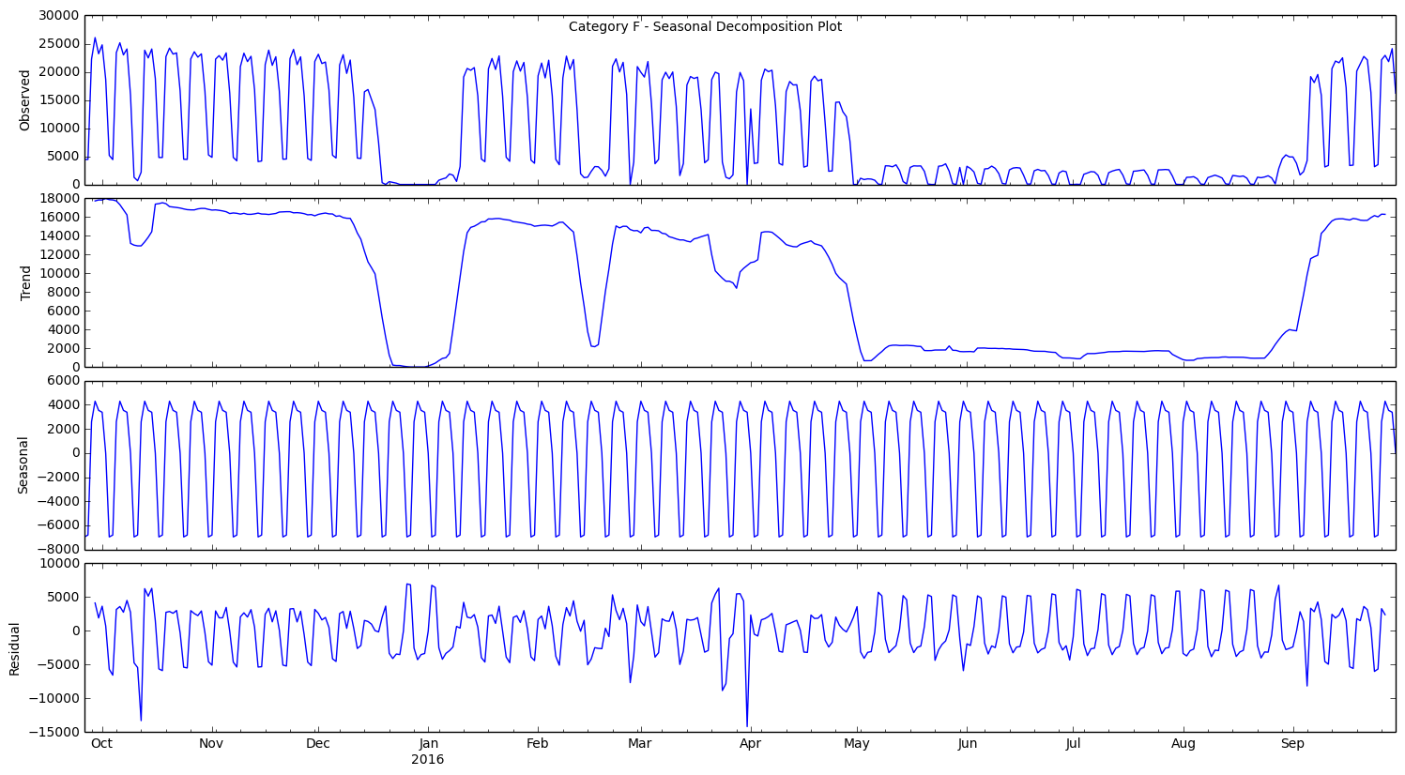
2) Data Exploratory (Site A) – Seasonal Decomposition Plot
Not an obvious trend; downwards trend in each quarter
Confirm the weekly seasonal behavior
Residual plots too regular; non-stationary

Slide 14
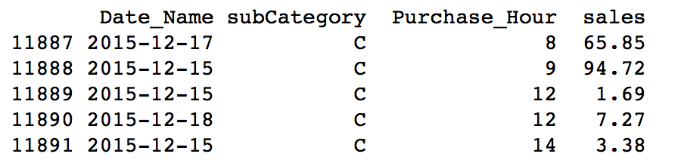
2) Data Exploration – Time Series Model
We have a time series data set
3 features; 2 are time based feature
Most common AR, MA, or Seasonal ARIMA models
Tree based models

Slide 15
Outline
Data Cleaning
Data Exploratory
Statistical Testing
Dickey-Fuller stationary test
ACF/PACF plots
Model Building
Forecasting
Improvements – XGBoost
Feature engineering
Parameters
Forecast

Slide 16
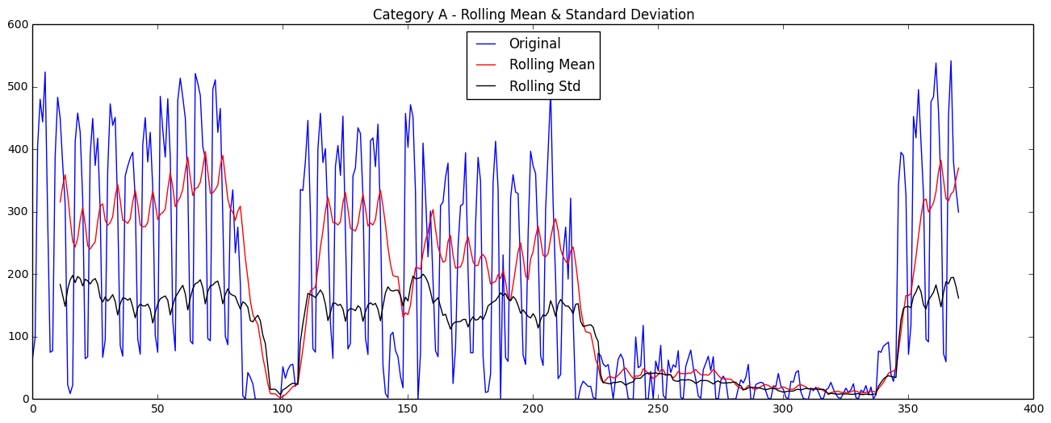
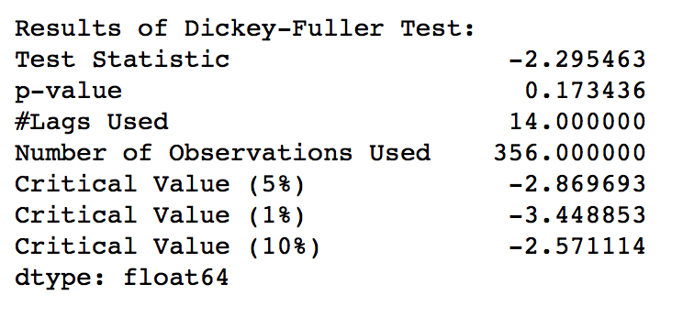
3) Statistical Testing – Dickey-Fuller Test
Does rolling mean changes a lot with time? -> Non-stationary
Does rolling standard deviation varies a lot with time? Non-stationary

Slide 17
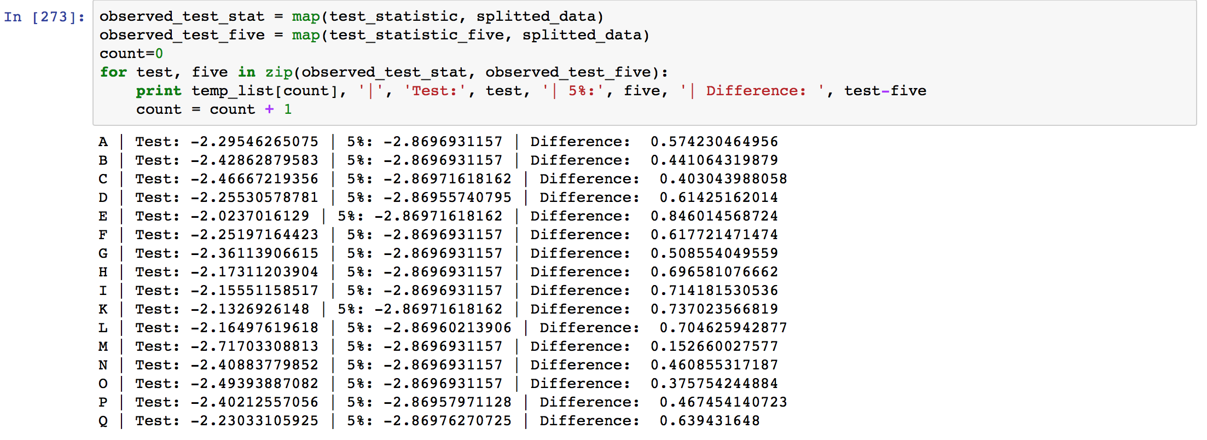
3) Statistical Testing – Dickey-Fuller Test
5% confidence test tells us it is not stationary
Test statistics > 5% confidence
Same for all other categories!

Slide 18
3) Statistical Testing - Transformations
Inversed(obs) – inverse hyperbolic sin
Diff(obs) – detrend, shift by 1 day
Diff(Inversed( ))
Seasonal(obs) – shift by 7 days
Seasonal(Inversed( ))
Seasonal(Diff( ))
Seasonal(Diff(Inversed( )))

Slide 19
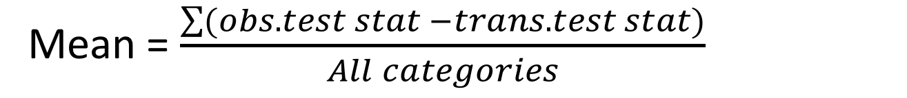
3) Statistical Testing - Transformations
Benchmark
Mean = $\frac{\sum{(obs. test stat −trans. test stat)}}{All categories}$
 | Inversed | Diff | Diff(Inv) | Sea() | Sea(Inv) | Sea(Diff) | Sea(Diff(Inv))
Mean(test stat) | 1.11 | 3.67 | 3.62 | 2.77 | 3.26 | 5.66 | 5.23
We will do further testing on these because:
There is definitely a seasonal effect
These 4 has good test statistics
Larger values means more confident the curve is stationary

Slide 20
Outline
Data Cleaning
Data Exploratory
Statistical Testing
Dickey-Fuller stationary test
ACF/PACF plots
Model Building
Forecasting
Improvements – XGBoost
Feature engineering
Parameters
Forecast

Slide 21
3) Statistical Testing – ACF/PACF Plots
Need to grid search for the best p, q, P, & Q values, but we want to know what range to search for
ACF/PACF plots tells us the range
We will plot ACF/PACF for these:
Seasonal(obs)
Seasonal(Inversed( ))
Seasonal(Diff( ))
Seasonal(Diff(Inversed( )))
Notes:
Change

Slide 22
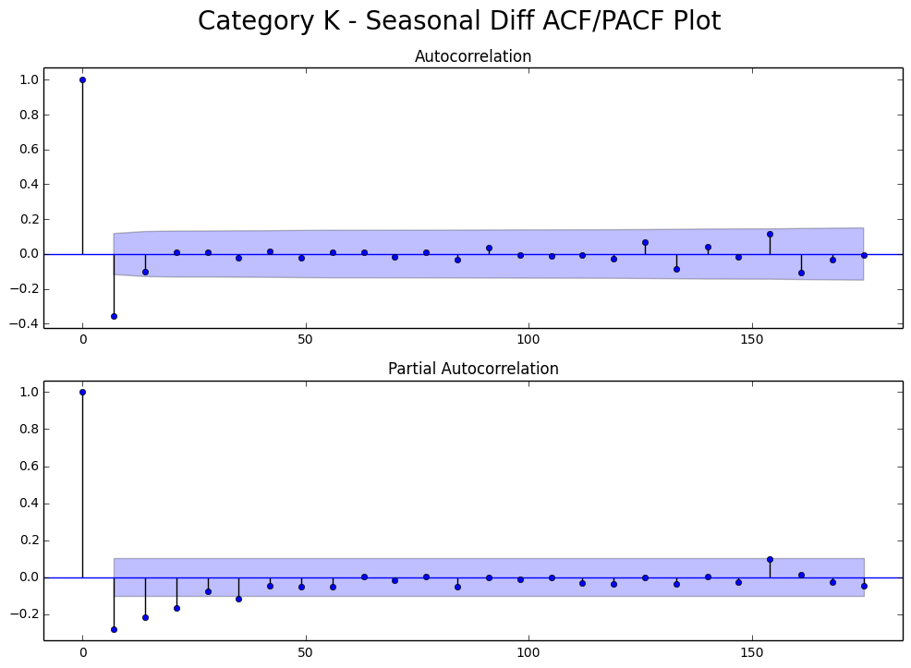
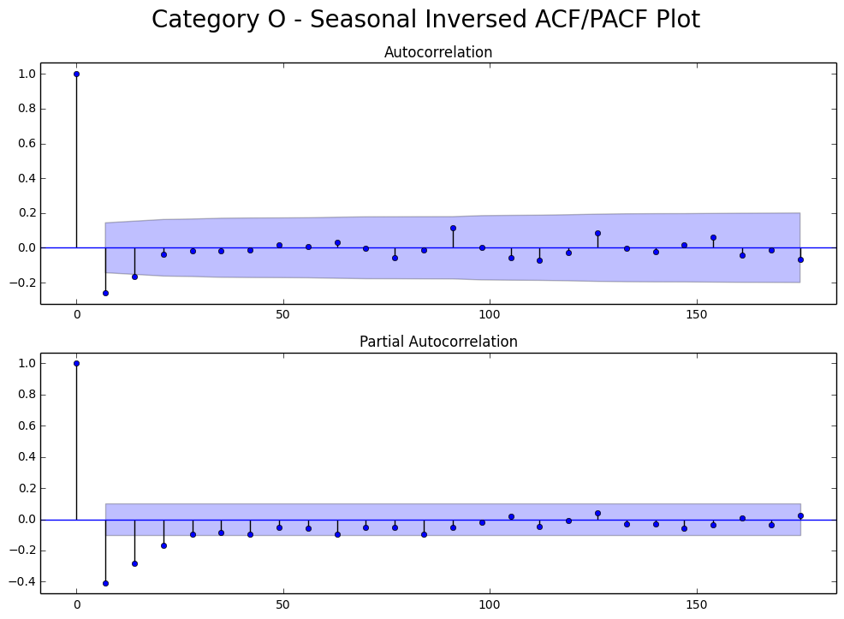
3) Statistical Testing – ACF/PACF Plots
Both tail off?
Or ACF cut at 2?
That’s why need grid search.
Clear cut off -> MA(1)

Slide 23
3) Statistical Testing – ACF/PACF Plots
We see mostly both plots tail off
Some are not clear, need grid search
Some have cut at most order of 1 or 2, so grid search range is 0~2
Both tail off?
Or ACF cut at 2?
That’s why need grid search.

Slide 24
Outline
Data Cleaning
Data Exploratory
Statistical Testing
Dickey-Fuller stationary test
ACF/PACF plots
Model Building
Forecasting
Improvements – XGBoost
Feature engineering
Parameters
Forecast

Slide 25
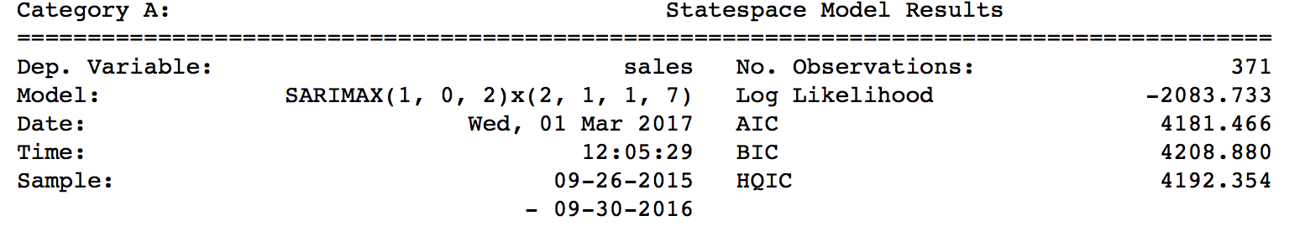
4) Model Building – Summary Output
Seasonal(obs)
Seasonal(Inversed( ))
Seasonal(Diff( ))
Seasonal(Diff(Inversed( )))
Grid search to minimize AIC
p
q
P
Q

Slide 26
4) Model Building – Compare Models
Take category (A) for example
Inversed result is always better than observed
De-trending didn’t make much difference – shift by 1 day
 | Sea() | Sea(Inv) | Sea(Diff) | Sea(Diff(Inv))
AIC – Category A | 4181 | 1094 | 4176 | 1099
SARIMA Model | (1, 0, 2) (2, 1, 1, 7) | (1, 0, 2) (0, 1, 1, 7) | (1, 1, 1) (2, 1, 1, 7) | (0, 1, 2) (0, 1, 1, 7)

Slide 27
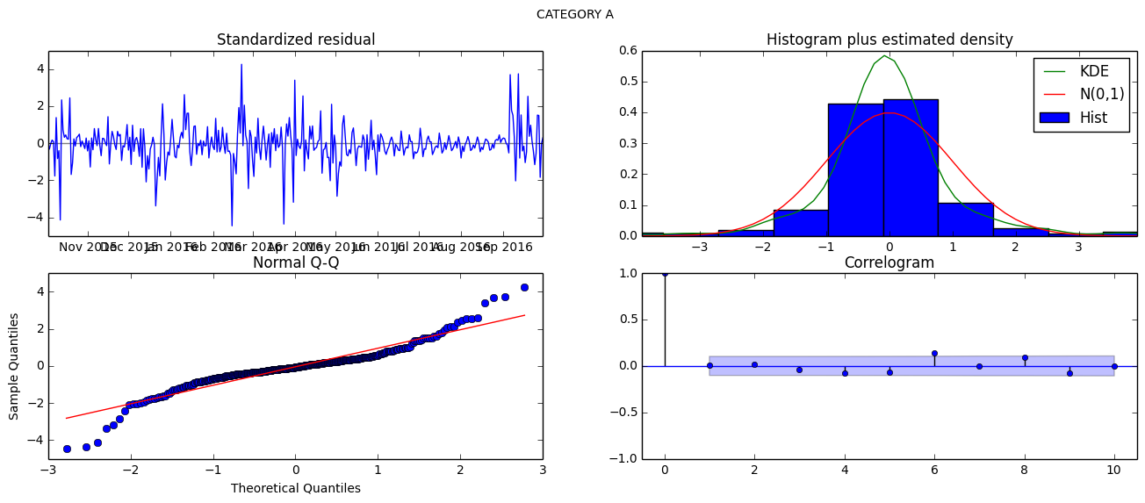
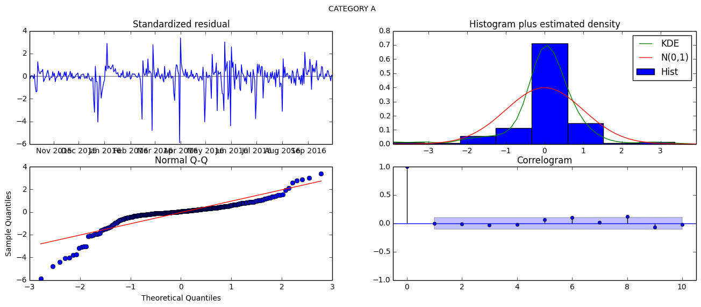
4) Model Building – Diagnostic Plots
Seasonal(Inversed( ))
Seasonal(observed)
Inversed does not have good residuals, even though its AIC/BIC is much lower

Slide 28
Outline
Data Cleaning
Data Exploratory
Statistical Testing
Dickey-Fuller stationary test
ACF/PACF plots
Model Building
Forecasting
Improvements – XGBoost
Feature engineering
Parameters
Forecast

Slide 29
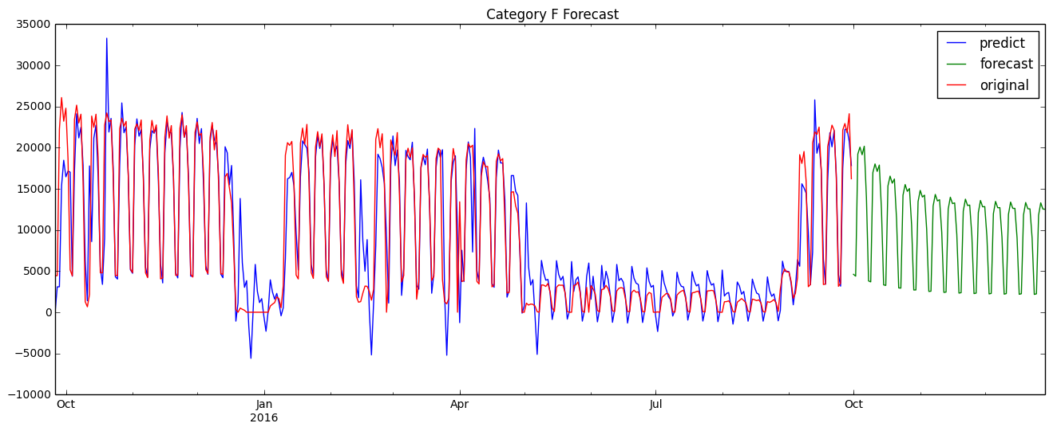
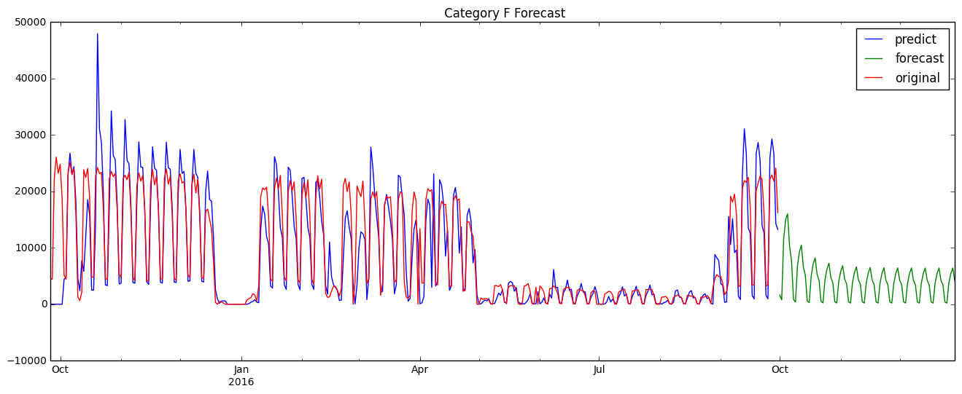
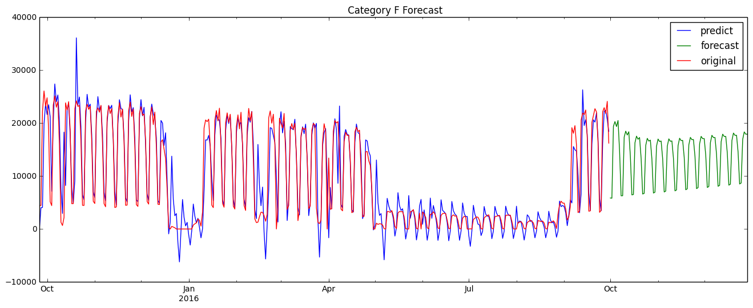
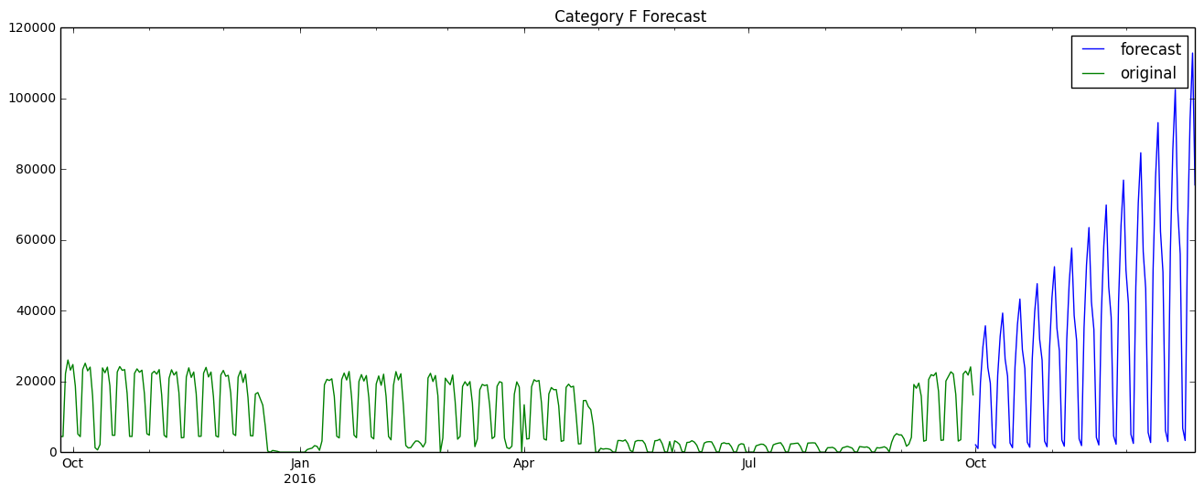
5) Forecasting (Category F) – Compare Models
Season(Obs)
Season(Inv)
Reasonable
Un-reasonable
Season(Diff)
Season(Diff(Inv))

Slide 30
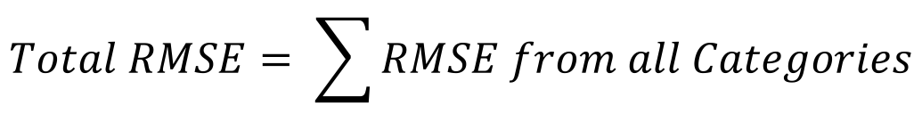
5) Forecasting – RMSE
$$Total RMSE= \sum{RMSE from all Categories}$$
Lesson:
Inverse hyperbolic sine gave really good AIC, but in reality it’s not true
Inversing also gave much better stationary test result
Recall:
 | Sea() | Sea(Inv) | Sea(Diff) | Sea(Diff(Inv))
Total In Sample RMSE | 17,222 | 22,448 | 17,051 | 228,504
 | Inversed | Diff | Diff(Inv) | Sea() | Sea(Inv) | Sea(Diff) | Sea(Diff(Inv))
Mean(test stat) | 1.11 | 3.67 | 3.62 | 2.77 | 3.26 | 5.66 | 5.23

Slide 31
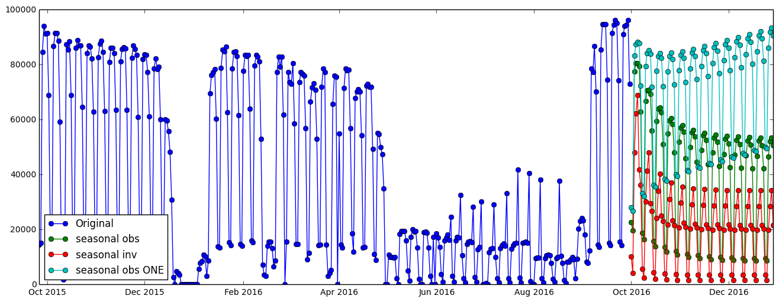
5) Forecasting (Site A) – Total Forecast
 | Sea() | Sea(Inv) | Sea(Diff) | Sea(Diff(Inv))
Total In Sample RMSE | 17,222 | 22,448 | 17,051 | 228,504

Slide 32
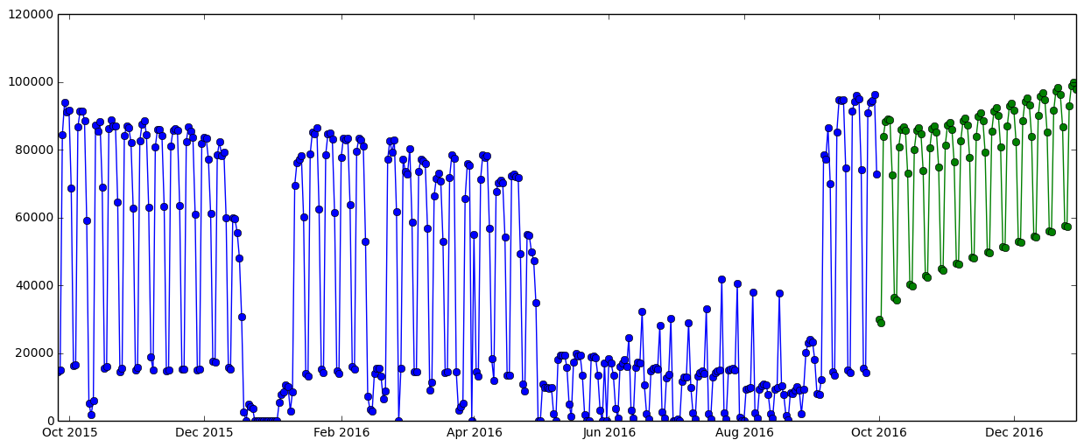
5) Forecasting (Site A) – Final Solution
A), B), E), H), N) – (1, 1, 1)x(2, 1, 1, 7)
C), M) – (2, 1, 1)x(1, 1, 1, 7)
D), F), G), I), K), L), O) – (1, 1, 1)x(1, 1, 1, 7)
P) – (0, 1, 2)x(1, 1, 1, 7)
Q) – (2, 1, 2)x(2, 1, 1, 7)
Seasonal(Diff)

Slide 33
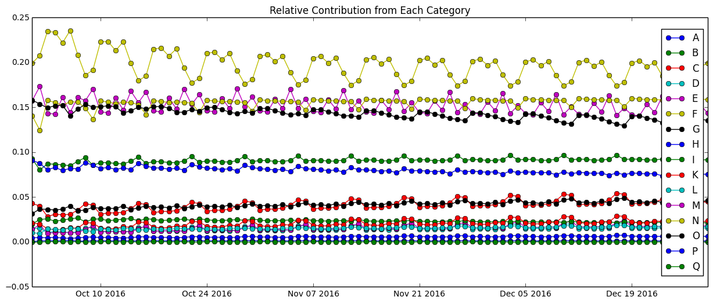
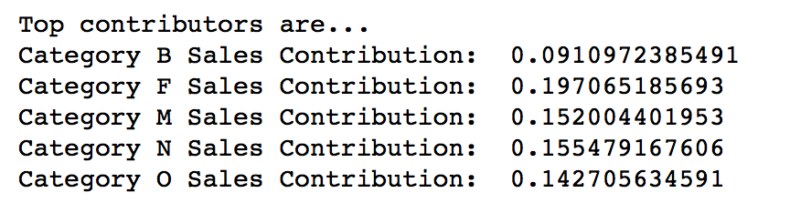
5) Forecasting (Site A) – Relative Contribution

Slide 34
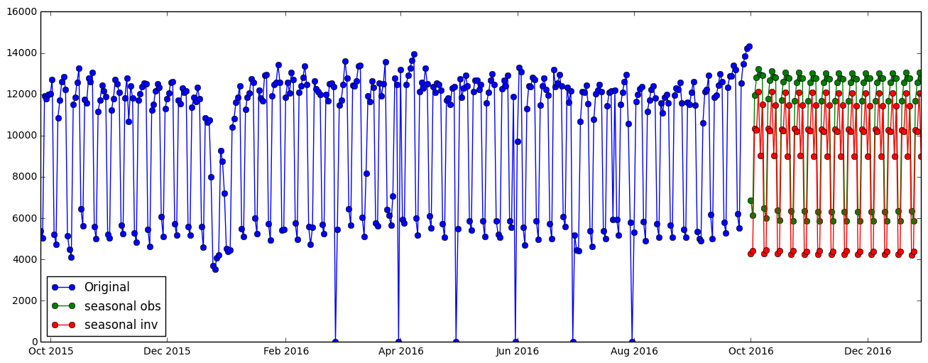
5) Forecasting (Site B) – Total Forecast
 | Season(Obs) | Season(Inv)
Total RMSE | 2514.16 | 2887.88

Slide 35
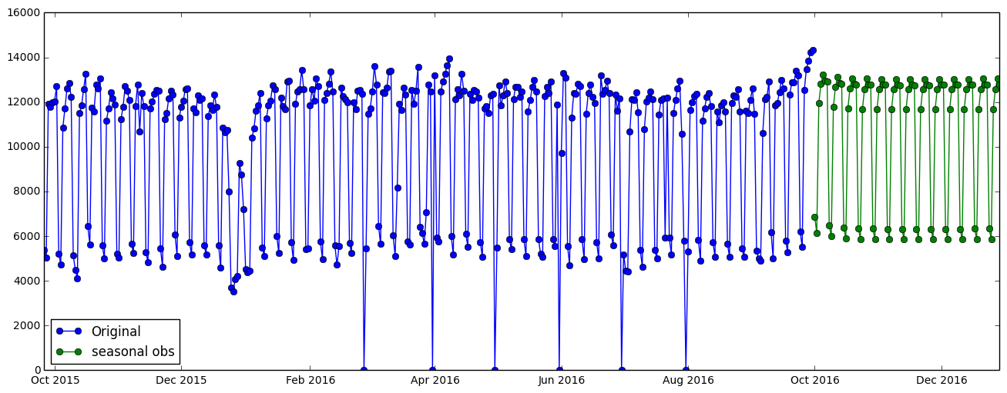
5) Forecasting (Site B) – Final Solution
A), B), I), M), N), O) (1, 0, 2)x(0, 1, 1, 7)
C) (1, 0, 0)x(0, 1, 1, 7)
D), L) (2, 0, 2)x(1, 1, 1, 7)
E) (1, 0, 2)x(2, 1, 1, 7)
F) (2, 0, 2)x(0, 1, 2, 7)
G), H) (2, 0, 0)x(0, 1, 1, 7)
K) (0, 0, 1)x(0, 1, 1, 7)
Q) (1, 0, 2)x(1, 1, 1, 7)
Seasonal(Obs)

Slide 36
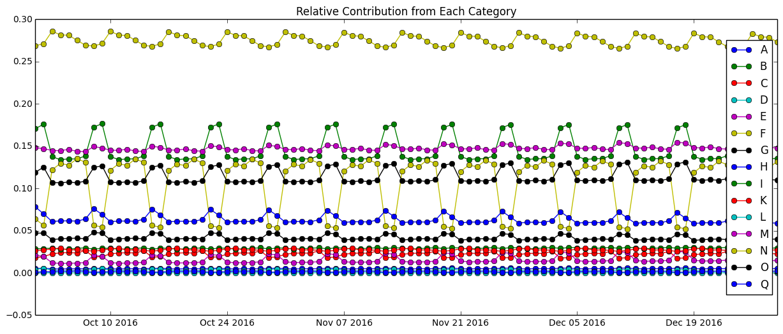
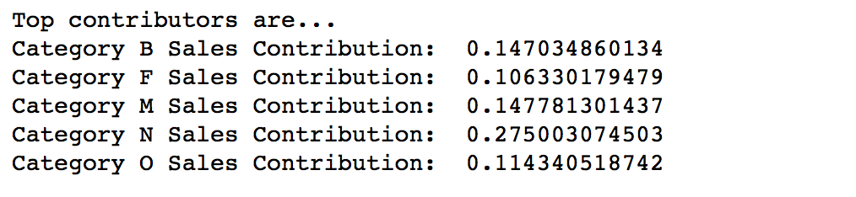
5) Forecasting (Site B) – Relative Contribution

Slide 37
Outline
Data Cleaning
Data Exploratory
Statistical Testing
Dickey-Fuller stationary test
ACF/PACF plots
Model Building
Forecasting
Improvements – XGBoost
Feature engineering
Parameters
Forecast

Slide 38
6) Improvement – Can We Do Better?
More data: if we have 5 years of data, we can definitely build more accurate models
More features:
weather data
promotion or not
number of competitors nearby
Diff models: we could try XGBoost

Slide 39
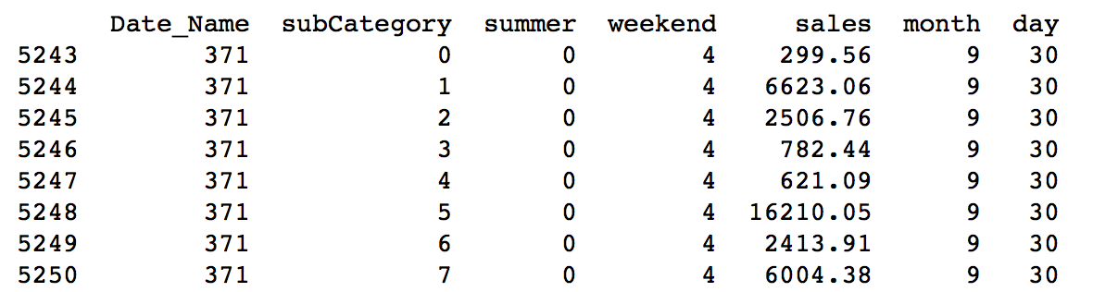
6) Improvement – Feature Engineering
Encoding categories
Date becomes sequence
Extracted Day
Summer or not
Extracted Month
Day of week

Slide 40
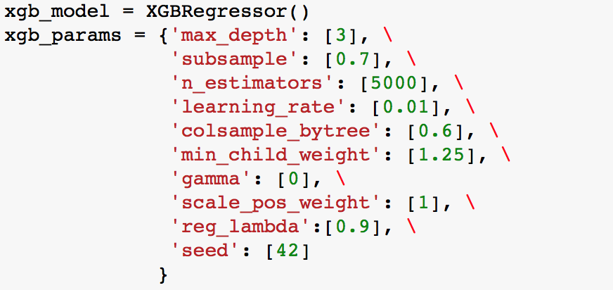
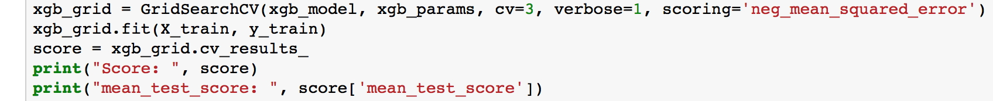
6) Improvement – XGBoost Parameters

Slide 41
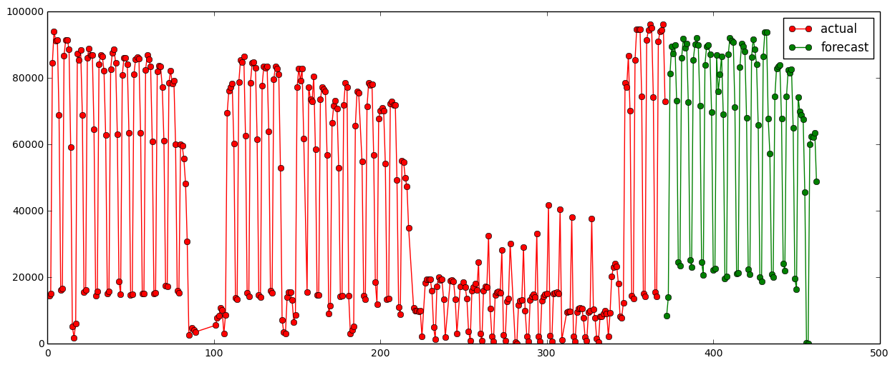
6) Improvement – XGBoost Forecast
 | Sea() | Sea(Diff) | XGBoost
Total RMSE | 17,222 | 17,051 | 2,865

Slide 42
6) Improvement – Next Steps
Merge 2 SARIMA models
Stack XGBoost with SARIMA model

Slide 43

Thank you! Questions?

Slide 44
Merge 2 SARIMA models
Stack XGBoost with SARIMA model

